Slide 1
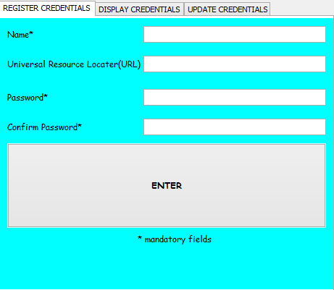
Button 1

Slide 2
Button 1

Slide 3
search
update
MASTER KEY
UPDATe
MASTER KEY
Update
MASTER KEY
MASTER KEY
UPDATe
Save
LOGIN
enter
SEARCH

